Slide 1
Introduction to SQL: Structured Query Language By App Jedi
www.appjedi.net

Slide 2

About the Instructor.
Bob has over 30 years experience with SQL including advanced queries. My experience includes Oracle, Microsoft SQL Server, MySQL, PostgreSQL and now Google BigQuery.
Originally from New York, I started my career in 1992 working for Apple Computer in Cupertino, California and have lived in California since working for Sutter Health, Accenture, Meta, General Electric.
Most of my career was at Sutter Health for 26 years working clinical data.
My teaching experience includes about ten years teaching at various colleges and universities in the Bay Area as adjunct faculty.

Slide 3
Review Syllabus.
Goals:
Basic SELECT statement for data retrieval.
Where clause filter rows.
Using wild cards.
Specifying columns and column aliases.
Order by (Sorting).
Limiting number of rows.
SQL Operators: Arithmetic, Comparison, Logical
SQL Null Functions:
Set Operations: UNION, UNION ALL, INTERSECT, EXCEPT
Sub queries.
Primary & Foreign Keys.
Joins: INNER, LEFT, RIGHT, SELF, OUTER.
Aggregates: COUNT, SUM, AVG, MIN, MAX.
Group By and Having (filter).
Views.
CTE: Common Table Expression, temp tables (with)
CASE statements.
Date functions.
String functions.
Numeric Functions.
Use Cases.
Remaining DML commands: INSERT, UPDATE, DELETE
SQL Injection.
Stored Procedures.
Materialized Views.
User Defined Function.
Table Function.
Python, JavaScript, Java connectivity.
Web JavaScript D3 graph example.
Windows Functions.

Slide 4
Extras:
Stored Procedures for multi-select queries.
Connectivity to languages like Python, Java, JavaScript
Data & AI – Python & SQL are the top two languages for Data & AI.
SQL vs. NoSQL

Slide 5
SQL is made up of four sub-languages:
DML (Data Manipulation Language is made up of four commands):
SELECT to query or READ data.
INSERT to add or CREATE data to a table
UPDATE to update data in a table.
DELETE to delete data from a table.
These commands map to the CRUD operations:
Create (INSERT), Read (SELECT), UPDATE, DELETE
Also:
DDL (Data Definition Language): CREATE, ALTER, DROP.
DCL (Data Control Language): GRANT & REVOKE.
TCL (Transaction Control Language): COMMIT, ROLLBACK, SAVEPOINT, SET TRANSACTION.
This course focuses on the SELECT command since it is the command to query data.

Slide 6
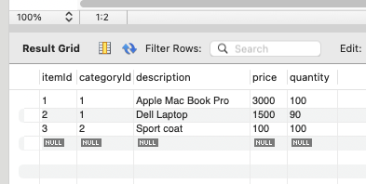
Basic Select command:
SELECT * FROM table – This is the most basic SELECT command.
* Means all columns.
SELECT * FROM items;

Slide 7
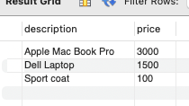
Limit columns returned.
SELECT column1, column2 -- Specify column names
FROM table
SELECT description, price FROM items;

Slide 8
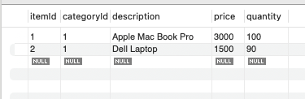
Filter rows with the where clause
SELECT *
FROM table
WHERE column1 = ? – WHERE is a filter to limit what rows are included.
SELECT * FROM items
WHERE price > 500;

Slide 9
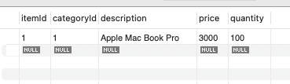
Compound where clause (AND)
SELECT *
FROM table
WHERE column1 = ? AND column2 = ? – Compound where clause
SELECT * FROM items
WHERE price > 500 AND quantity>90;

Slide 10
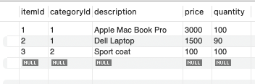
Compound where clause (OR)
SELECT *
FROM table
WHERE column1 = ? OR column2 = ? – Compound where clause
SELECT * FROM items
WHERE price > 500 OR quantity>90;

Slide 11
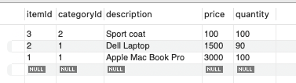
Sorting results ascending (ORDER BY)
SELECT *
FROM table
ORDER BY column1 – order the rows by one or more columns.
SELECT * FROM items
ORDER BY price ASC – default.

Slide 12

Sorting results (ORDER BY)
SELECT *
FROM table
ORDER BY column1 – order the rows by one or more columns.
SELECT * FROM items
ORDER BY price DESC

Slide 13

Compound Sorting results (ORDER BY)
SELECT *
FROM table
ORDER BY column1, column2
SELECT * FROM items
ORDER BY price, quantity

Slide 14

Limiting number of rows (LIMIT)
SELECT * FROM table LIMIT n
SELECT * FROM items LIMIT 1;

Slide 15
Wild Cards (LIKE)
Two wild cards:
% match 0 to many characters.
_ match one character.
LIKE ‘ice%’. The column starts with “ice”
LIKE ‘%Signs%’. The column contains with “Signs”
LIKE ‘%Signs’. The column ends with “Signs”

Slide 16
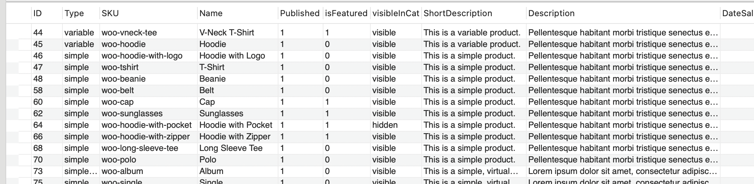
Example
SELECT * FROM appjedin_student_temp.products
WHERE sku LIKE 'woo%';

Slide 17
Example
SELECT * FROM appjedin_student_temp.products
WHERE sku NOT LIKE 'woo%';

Slide 18
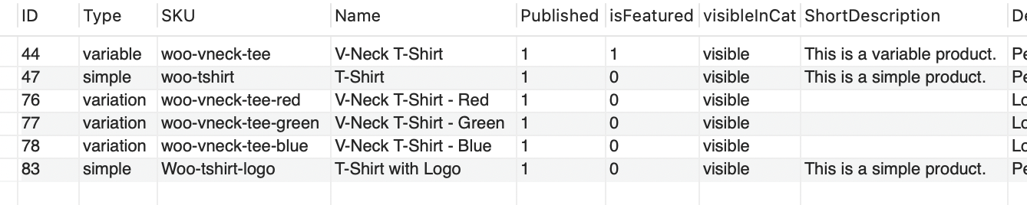
Example
SELECT * FROM appjedin_student_temp.products
WHERE name LIKE '%shirt%';

Slide 19
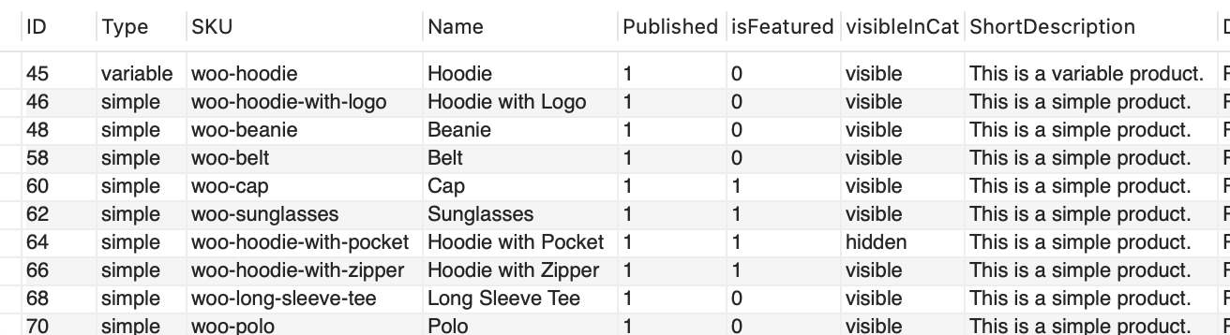
NOT LIKE
SELECT * FROM appjedin_student_temp.products
WHERE name NOT LIKE '%shirt%';

Slide 20
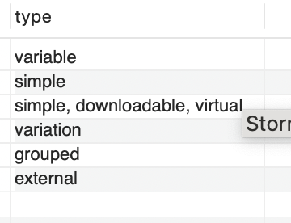
DISTINCT
DISTINCT ROWS
SELECT DISTINCT type
FROM appjedin_student_temp.products

Slide 21
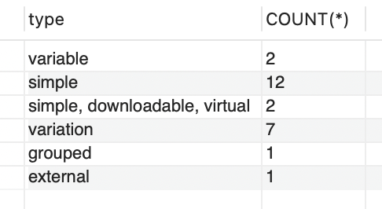
COUNT Aggregate
SELECT type, COUNT(*)
FROM appjedin_student_temp.products
GROUP BY type;

Slide 22
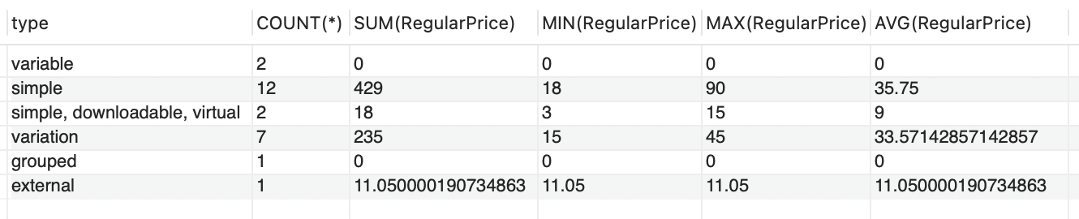
Aggregates
COUNT of all rows [that meet filter].
SUM of a numeric column [that meet filter].
AVG – Average of a numeric column [that meet filter].
MIN – minimum value of a field.
MAX – maximum value of a field.
SELECT type, COUNT(*), SUM(RegularPrice), MIN(RegularPrice), MAX(RegularPrice), AVG(RegularPrice)
FROM appjedin_student_temp.products
GROUP BY type;

Slide 23
Thank You
Introduction to SQL:
Structured Query Language
Session One

